Slide 1
Marketing Research Team Project
Cluster Analysis of Coffee Consumption
[도팀] 201143184 박동규 201461112 배서연

Slide 2
CONTENTS
Proposed background
Questionnaire configuration
Analysis process
Analysis conclusion
Limitation of project

Slide 3



PROPOSED BACKGROUND
The behavior of coffee consumption
the lifestyle of 20 generations
An steady increase in Coffee consumption
Notes:
* Korean is steady consuming coffee more and more.
* We wondered if there are a lifestyle that have a significant impact on coffee consumption.
Therefore, a survey was conducted for people in their 20s
to see the link between lifestyle and coffee consumption habits. We used the data from the questionnaire and R program.

Slide 4




QUESTIONNAIRE CONFIGURATION
Questionnaire
The behavior of coffee consumption according to the lifestyle of 20 generations
Coffee consumption habit
Lifestyle of 20 generations
Demographic characteristics
Notes:
The questionnaire is consist of three part

Slide 5
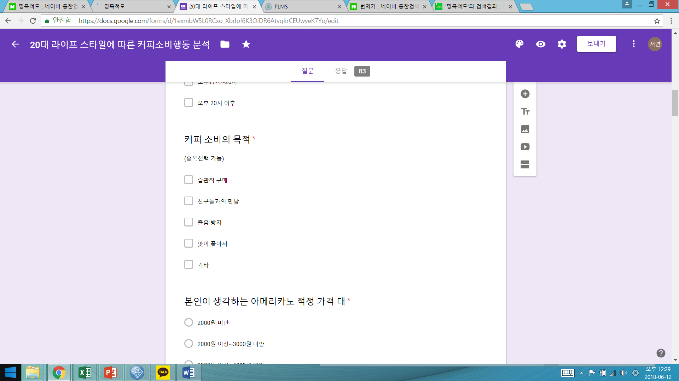
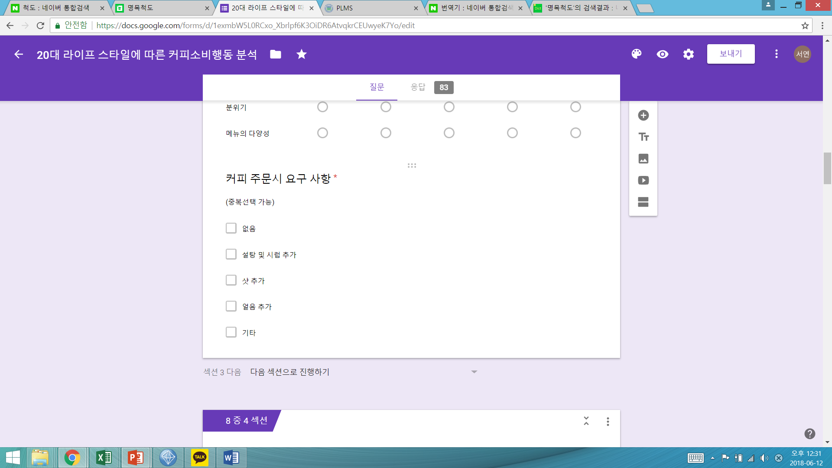
QUESTIONNAIRE CONFIGURATION
How many times do you buy coffee per week?
What time do you usually buy coffee?
What is the purpose when u buy coffee?
what is the reasonable price of americano that you think
what is the important factor when
you choose a café
what do u demand when you buy coffee?
<Coffee consumption habit>
Questionnaire
The behavior of coffee consumption according to the lifestyle of 20 generations
1) How many times do you buy coffee per week?
2) What time do you usually buy coffee?
3) Why do you buy coffee?
4) what is the reasonable price of Americano you think?
5) what is the important factor when you
choose a café?
6) what do u demand when you buy coffee?
Coffee consumption habit
Lifestyle of 20 generations
Demographic characteristics
Notes:
The questionnaire is consist of three part
The first part of survey includes six question to know habits that people have when they buy some coffee.
How many times you buy coffee per week
What time you buy coffee routinely
The purpose when u buy coffee
The reasonable price of americano that you think
The important factor when you choose a café
The demand when you order coffee at the cafe
2. We referred to the preceding study to analyse lifestyles and modified them accordingly to suit the purpose of this study.
Among the lifestyle categories classified in the preceding study.
We selected six categories of lifestyle that might be related to coffee consumption habit by conducting focus group interview with people surround us.
Taste pursuit, economic pursuit, health pursuit, cultural lifestyle pursuit, social pursuit, fashion pursuit.
For example, we think people who have sensitive taste is likely to consume more expensive coffee than others so we select taste pursuit category.
3. The last part is about Demographic characteristics.
Gender, age, education level, Residence, occupation, Monthly average income, An monthly average expense when you eat outside.
월평균 소득과 평균 외식지출비에 따라 커피소비 정도가 달라질 거라고 생각했떄문에

Slide 6
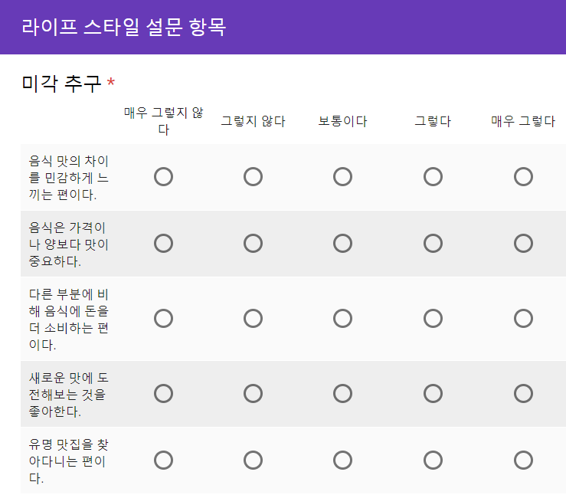
QUESTIONNAIRE CONFIGURATION
<Lifestyle of 20 generations>
Questionnaire
The behavior of coffee consumption according to the lifestyle of 20 generations
> Referred to the preceding study
and modified them accordingly
> conducted focus group interview
> Selected six categories of lifestyle
that might be related to coffee
consumption habit
Coffee consumption habit
Lifestyle of 20 generations
Demographic characteristics
Taste pursuit economic pursuit
Health pursuit cultural lifestyle pursuit
Social pursuit fashion pursuit
Notes:
The questionnaire is consist of three part
The first part of survey includes six question to know habits that people have when they buy some coffee.
How many times you buy coffee per week
What time you buy coffee routinely
The purpose when u buy coffee
The reasonable price of americano that you think
The important factor when you choose a café
The demand when you order coffee at the cafe
2. We referred to the preceding study to analyse lifestyles and modified them accordingly to suit the purpose of this study.
Among the lifestyle categories classified in the preceding study.
We selected six categories of lifestyle that might be related to coffee consumption habit by conducting focus group interview with people surround us.
Taste pursuit, economic pursuit, health pursuit, cultural lifestyle pursuit, social pursuit, fashion pursuit.
For example, we think people who have sensitive taste is likely to consume more expensive coffee than others so we select taste pursuit category.
3. The last part is about Demographic characteristics.
Gender, age, education level, Residence, occupation, Monthly average income, An monthly average expense when you eat outside.
월평균 소득과 평균 외식지출비에 따라 커피소비 정도가 달라질 거라고 생각했떄문에

Slide 7
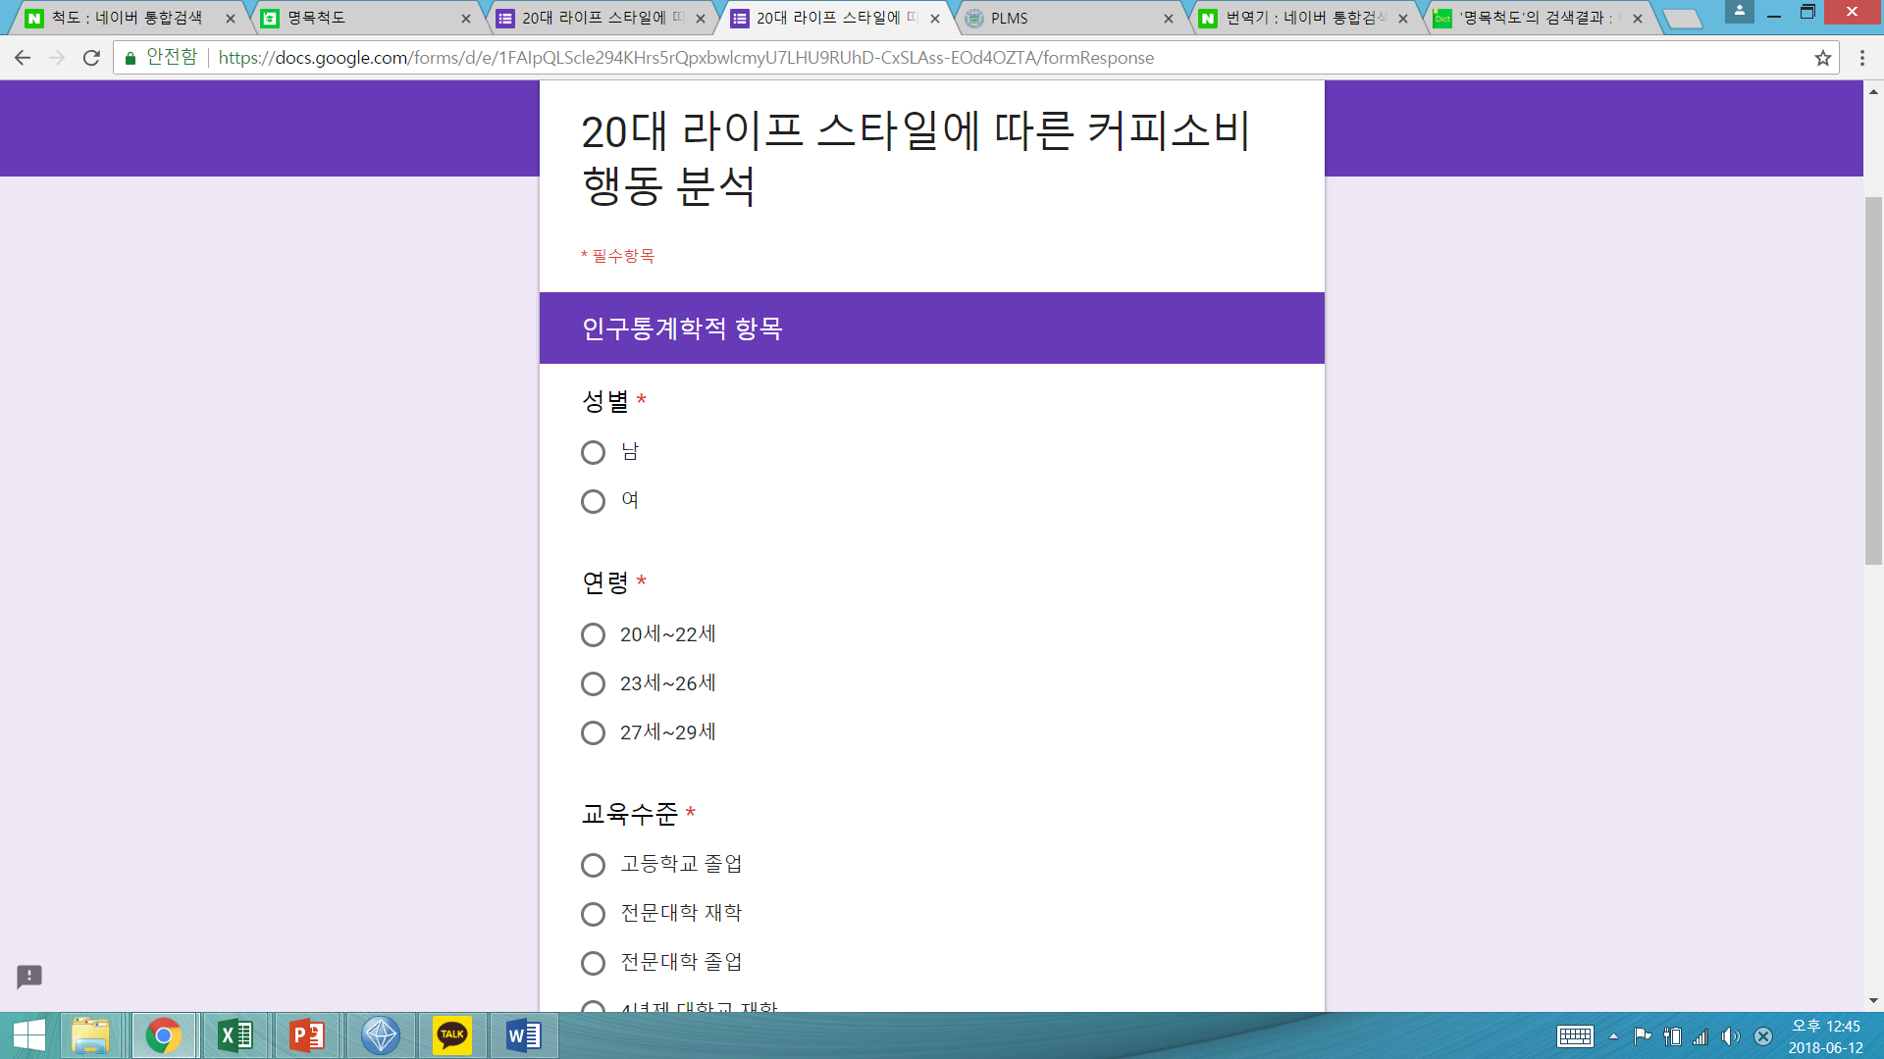
QUESTIONNAIRE CONFIGURATION
How many times do you buy coffee per week?
What time do you usually buy coffee?
What is the purpose when u buy coffee?
what is the reasonable price of americano that you think
what is the important factor when
you choose a café
what do u demand when you buy coffee?
<Demographic characteristics>
Questionnaire
The behavior of coffee consumption according to the lifestyle of 20 generations
Gender 2) Age
3) Education level 4) Residence
5) Occupation
6) Monthly average income
7) An monthly average expense when u eat outside.
Coffee consumption habit
Lifestyle of 20 generations
Demographic characteristics
Notes:
The questionnaire is consist of three part
The first part of survey includes six question to know habits that people have when they buy some coffee.
How many times you buy coffee per week
What time you buy coffee routinely
The purpose when u buy coffee
The reasonable price of americano that you think
The important factor when you choose a café
The demand when you order coffee at the cafe
2. We referred to the preceding study to analyse lifestyles and modified them accordingly to suit the purpose of this study.
Among the lifestyle categories classified in the preceding study.
We selected six categories of lifestyle that might be related to coffee consumption habit by conducting focus group interview with people surround us.
Taste pursuit, economic pursuit, health pursuit, cultural lifestyle pursuit, social pursuit, fashion pursuit.
For example, we think people who have sensitive taste is likely to consume more expensive coffee than others so we select taste pursuit category.
3. The last part is about Demographic characteristics.
Gender, age, education level, Residence, occupation, Monthly average income, An monthly average expense when you eat outside.
월평균 소득과 평균 외식지출비에 따라 커피소비 정도가 달라질 거라고 생각했떄문에

Slide 8
ANALYSIS PROCESS
data = read.csv("C:\\Users\\dgpar\\Desktop\\MarketingResearch\\coffee_data2.csv")
head(data)
colnames(data) <- c("id", "consumePerWeek", "buyingTime", "PurposeOfBuying", "rationalPrice", "weightTaste", "weightPrice", "weightBrand","weightAtmosphere", "weightVariety", "requirement", "taste1", "taste2", "taste3", "taste4", "taste5", "saving1", "saving2", "saving3", "saving4", "saving5", "health1", "health2", "health3", "health4", "cultural1", "cultural2", "cultural3", "cultural4" ,"sociality1", "sociality2", "sociality3", "sociality4", "sociality5", "trend1", "trend2", "trend3", "trend4", "trend5", "gender", "age", "educationLevel", "livingStyle", "occupation", "income1", "income2", "eatingOutExpenses")
head(data)
1.read dataset
2.data preprocessing
df <- data.frame(data$id)
# column1
data$consumePerWeek <- gsub("0번", 0, data$consumePerWeek)
data$consumePerWeek <- gsub("1~3번", 2, data$consumePerWeek)
data$consumePerWeek <- gsub("4~6번", 5, data$consumePerWeek)
data$consumePerWeek <- gsub("7~9번", 8, data$consumePerWeek)
data$consumePerWeek <- gsub("10~12번", 11, data$consumePerWeek)
data$consumePerWeek <- gsub("13번 이상", 14, data$consumePerWeek)
data$consumePerWeek <- as.numeric(data$consumePerWeek)
head(data$consumePerWeek)
consumePerWeek <- data$consumePerWeek
df <- cbind(df, consumePerWeek)
data$rationalPrice <- gsub("2000원 미만", 1500, data$rationalPrice)
data$rationalPrice <- gsub("2000원 이상~3000원 미만", 2500, data$rationalPrice)
data$rationalPrice <- gsub("3000원 이상~4000원 미만", 3500, data$rationalPrice)
data$rationallePrice <- gsub("4000원 이상", 4500, data$rationalPrice)
data$rationalPrice <- as.numeric(data$rationalPrice)
rationalPrice <- data$rationalPrice
df <- cbind(df, rationalPrice)
colnames(data)
for(i in 6:10){
data[,i] <- gsub("1점", 1, data[,i])
data[,i] <- gsub("2점", 2, data[,i])
data[,i] <- gsub("3점", 3, data[,i])
data[,i] <- gsub("4점", 4, data[,i])
data[,i] <- gsub("5점", 5, data[,i])
data[,i] <- as.numeric(data[,i])
}
weightTaste <- data$weightTaste
df <- cbind(df, weightTaste)
weightPrice <- data$weightPrice
df <- cbind(df, weightPrice)
weightBrand <- data$weightBrand
df <- cbind(df, weightBrand)
weightAtmosphere <- data$weightAtmosphere
df <- cbind(df, weightAtmosphere)
weightVariety <- data$weightVariety
df <- cbind(df, weightVariety)
Notes:
설문자료를 수집하고, 자료분석을 위해 R프로그램을 사용하였다.
우선 데이터를 불러오고,
문자형으로 되어있는 설문결과를 숫자형식으로 변환하고, 데이터 프레임을 새로 만들었다 보기와 같이.
We collected the information from questionnaire and used R program to analysis them.
First, we brought data from survey and converted text type data into numeric format data.
We made new data frame as you can see in the screen

Slide 9
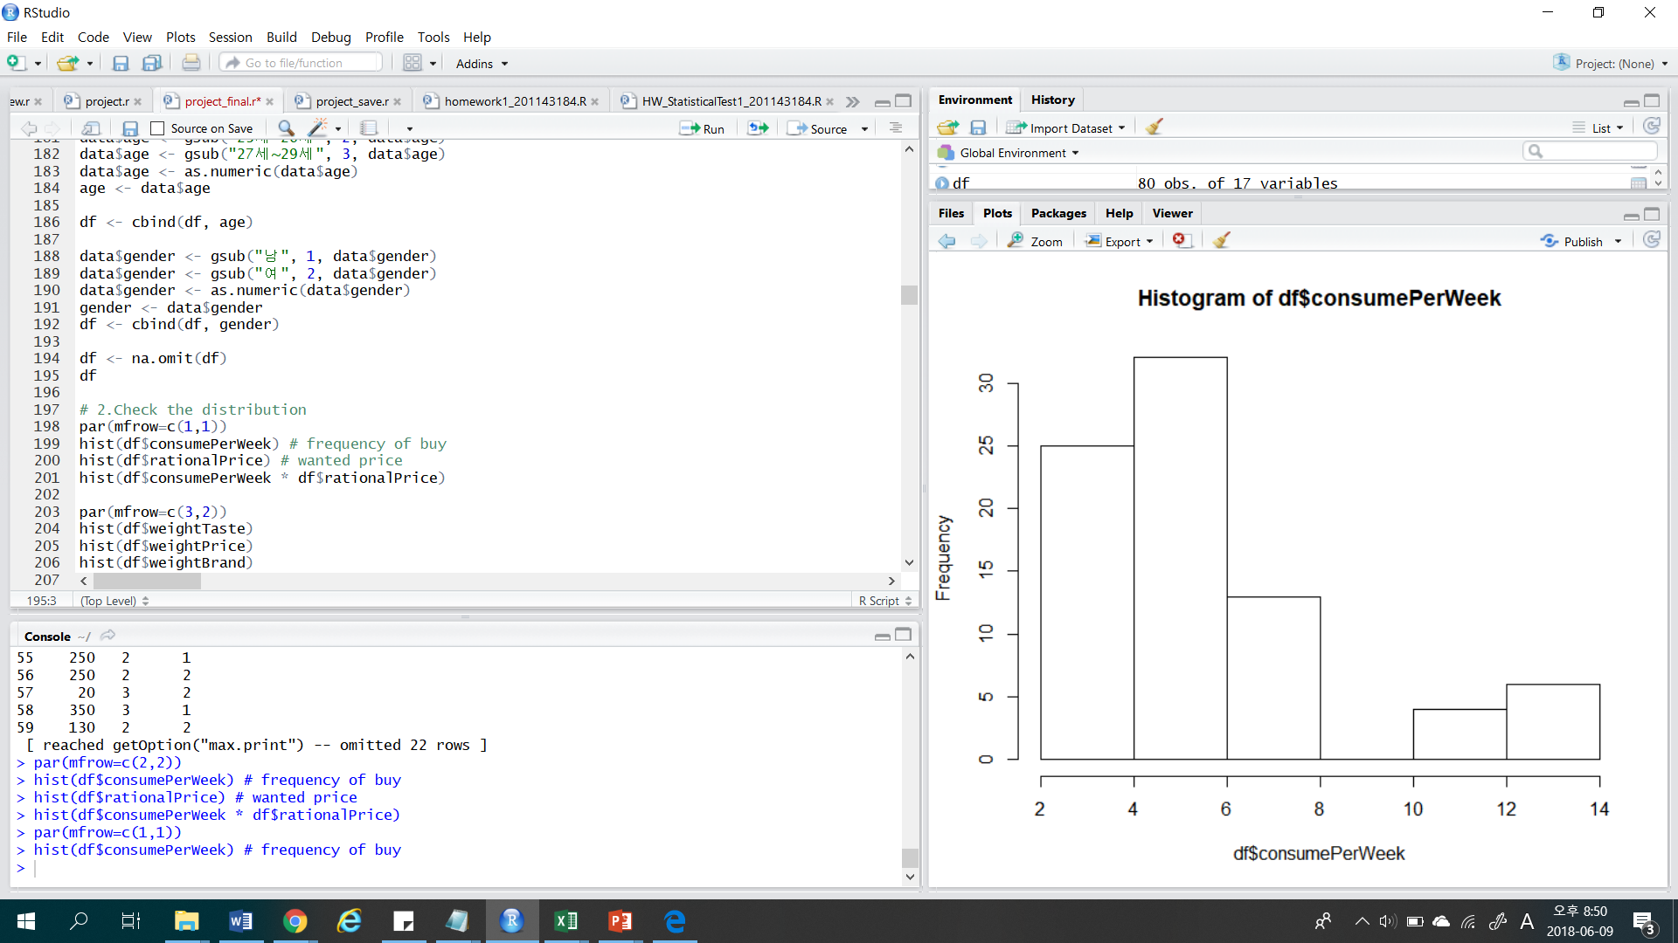
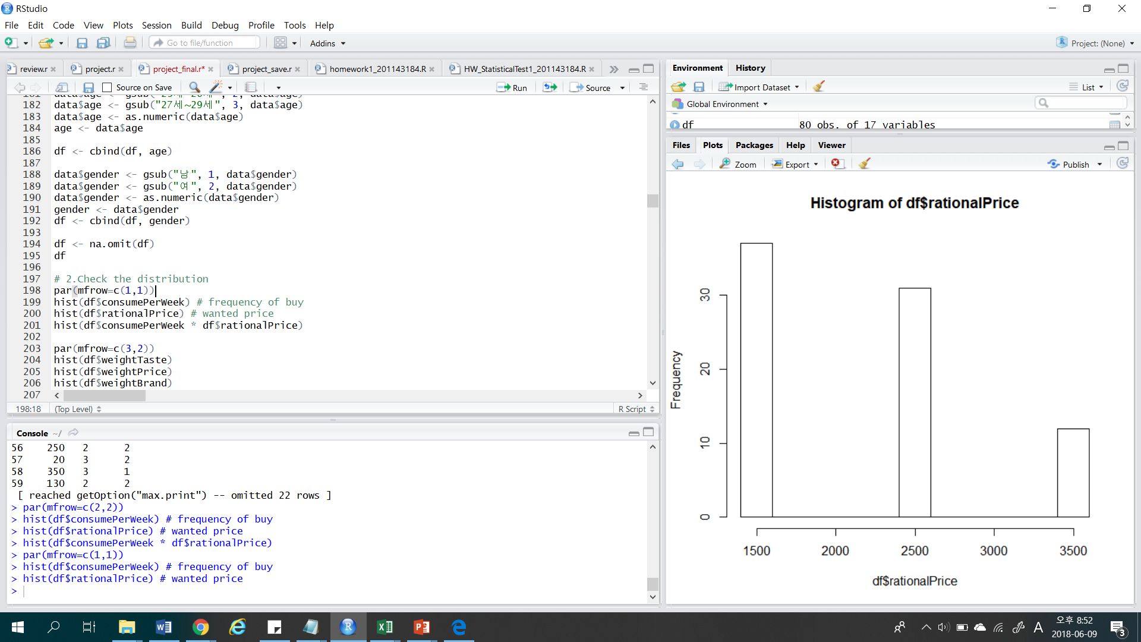
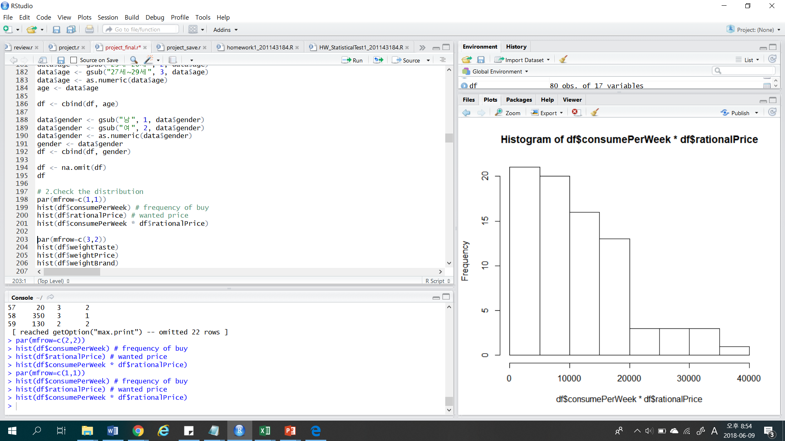
ANALYSIS PROCESS
Histograms of survey results
We made a new variable using coffee consumption & rational price variables.
Coffee consumption (per week) x rational price = purchase amount (per week).
Coffee Consumption
Rational Price
Purchase amount
x
=
Notes:
from now on, I will continue the presentation. I will skip some slide fastly because of time.
After finished data preprocessing, we made a new variables that would be used later.

Slide 10
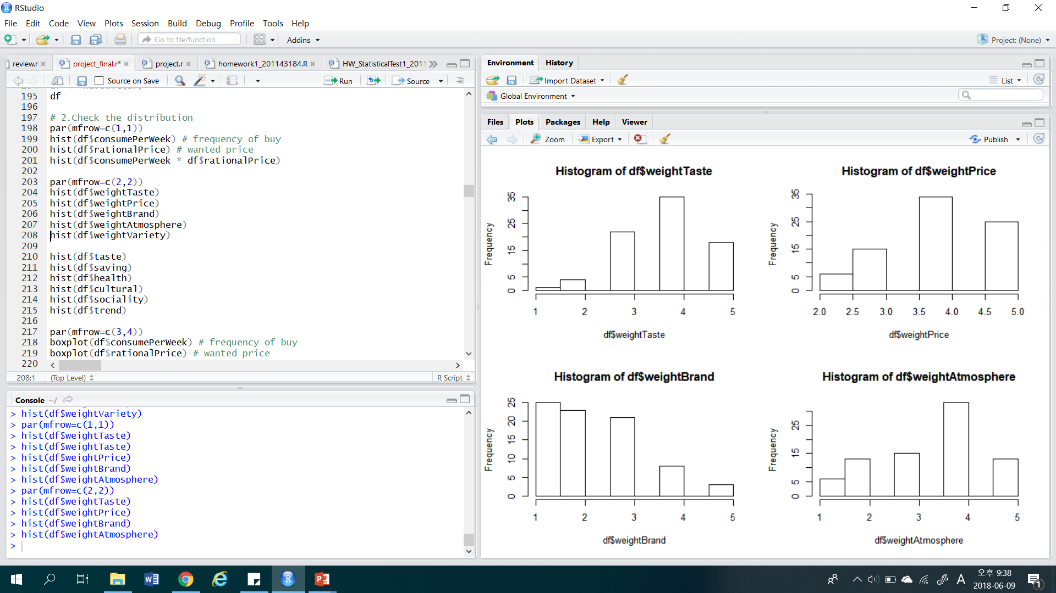
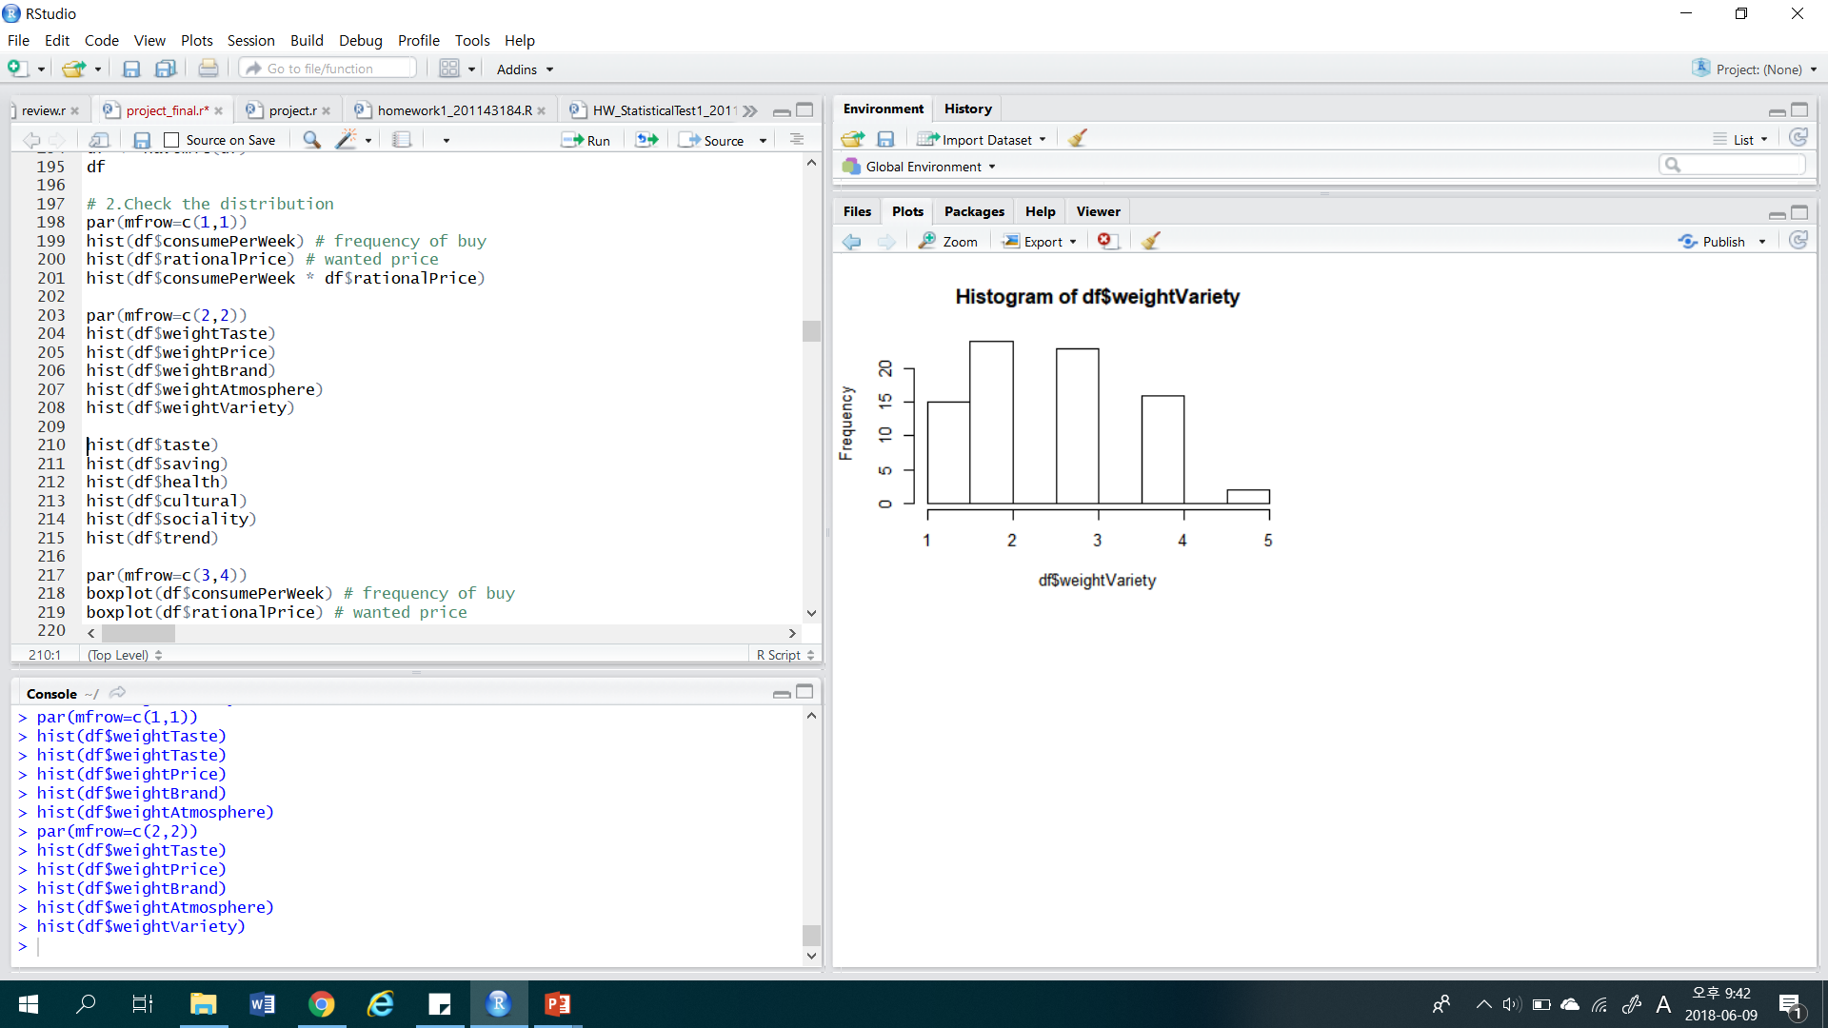
ANALYSIS PROCESS
Histograms of survey results
- Weighted Value
Notes:
Then, we looked at the factors people consider when they buy coffee.
In our opinion, we just thought that people usually consider taste in some degree,
and don't mind about brand that much.

Slide 11
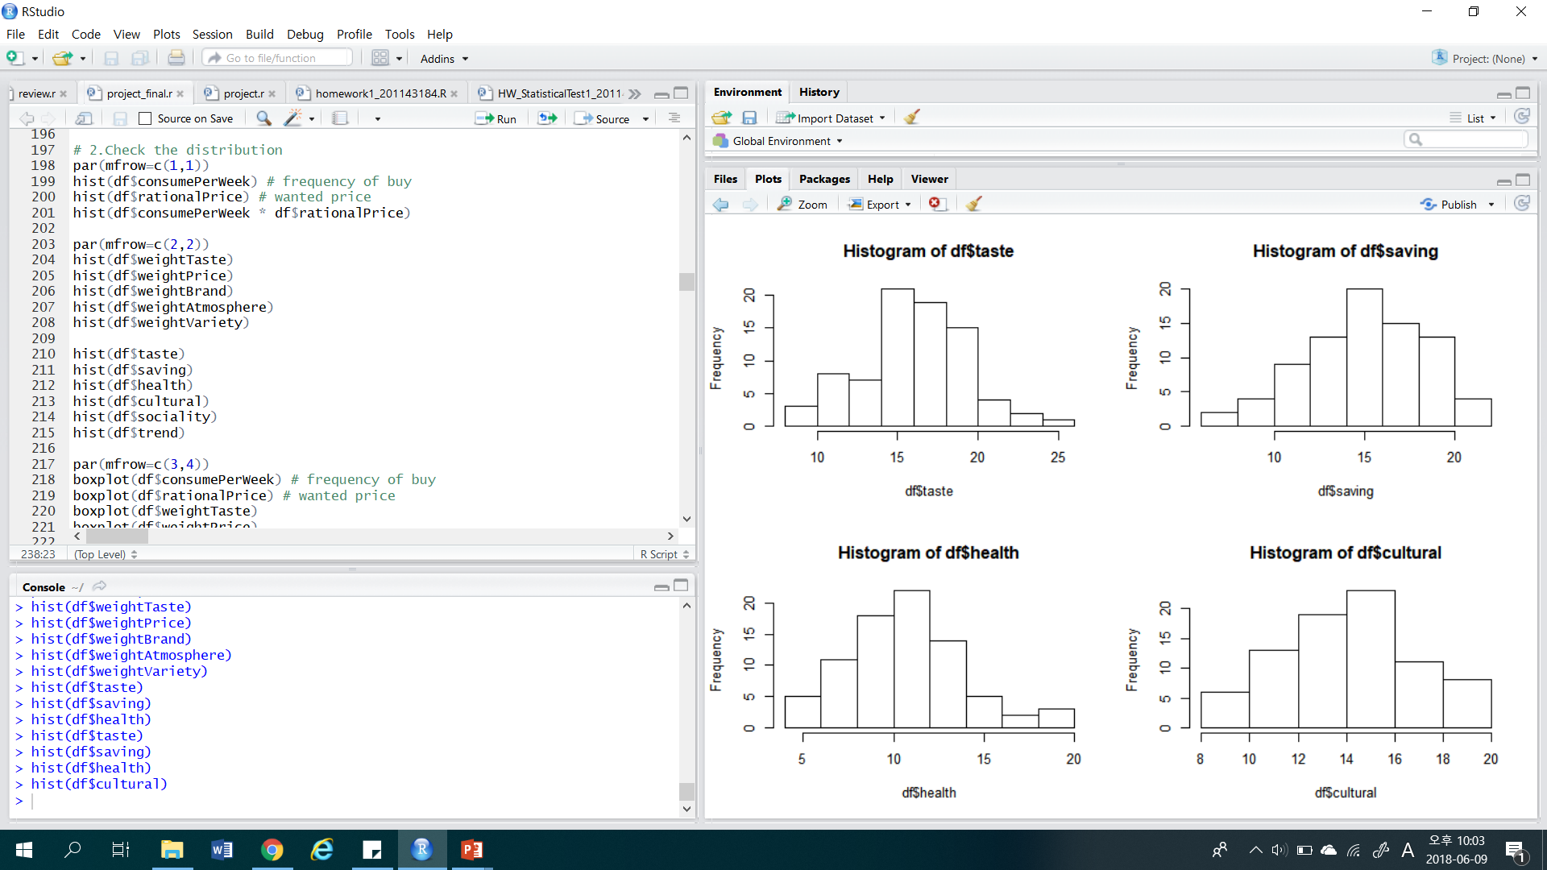
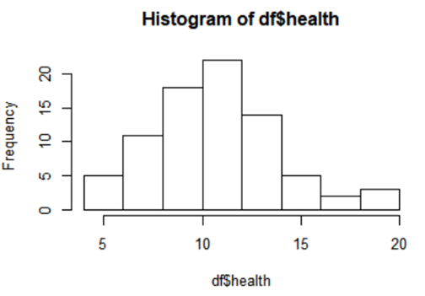
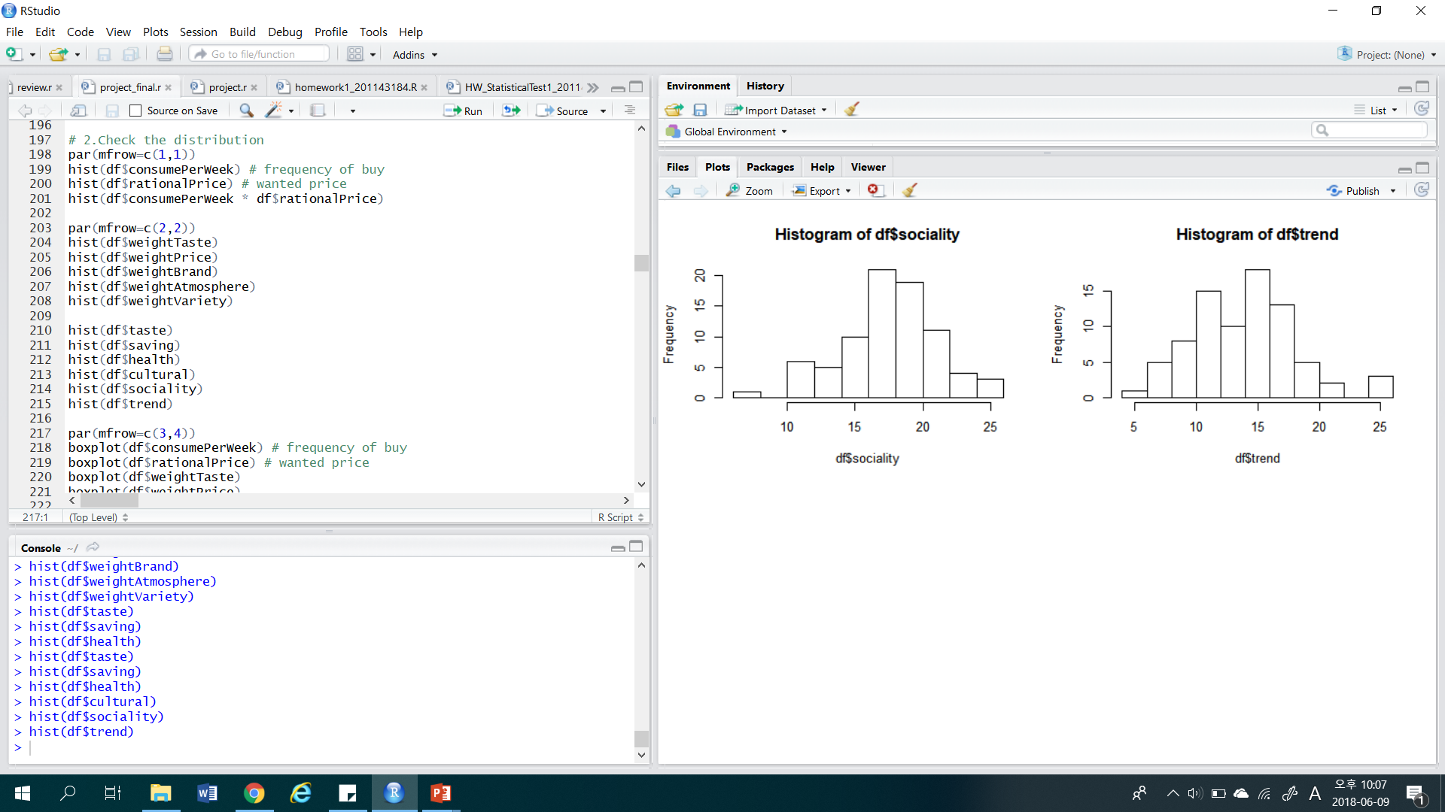
ANALYSIS PROCESS
Histograms of survey results
- Life style
Histogram of lifestyle looks like a normal distribution.
Notes:
lifestyle variables looks like a normal distribution.
At this point, we could check the difference of distribution using anova test or t - test.
But, We thought that we can't find useful insight if we use just this data.
We learned a lot of times about STP strategy when we took marketing classes.
So, We planned to do clustering to segement customers.

Slide 12
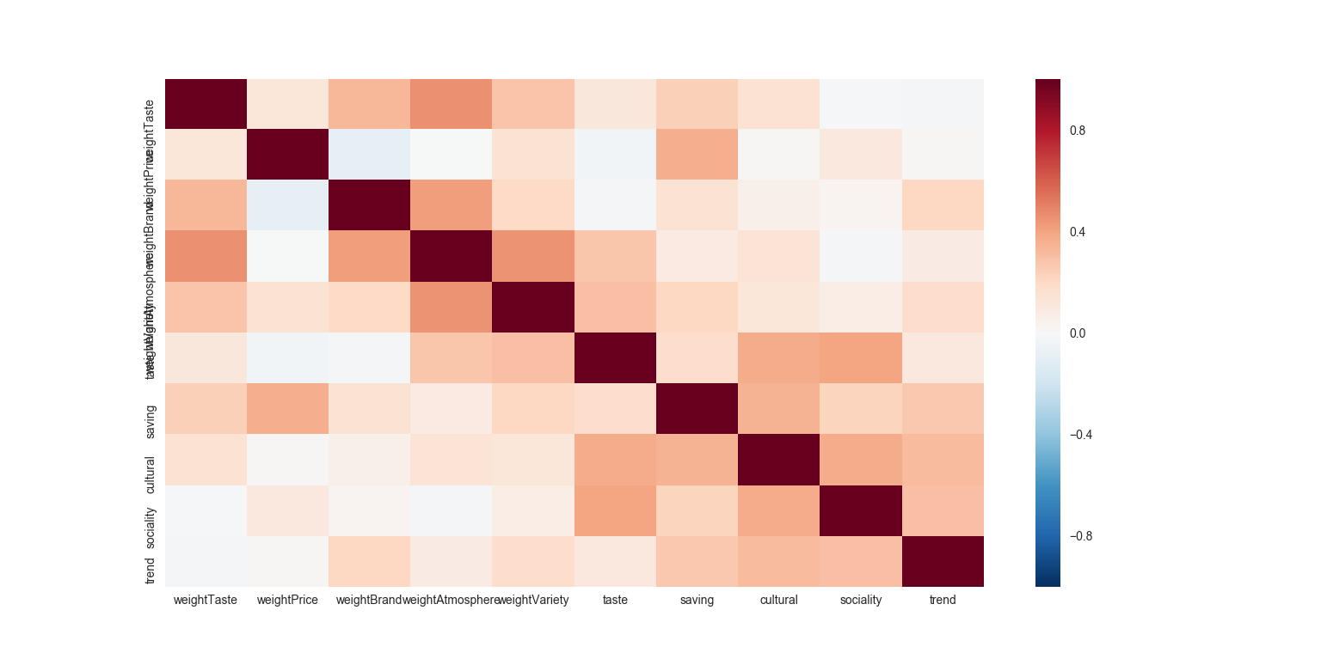
ANALYSIS PROCESS
Multiple Regression
Check correlations
There was no significant correlations between variables.
Notes:
Before then, To check meaningful variables, we used the multiple regressions.
when we looked at the correlations, there was no significant correlations.

Slide 13
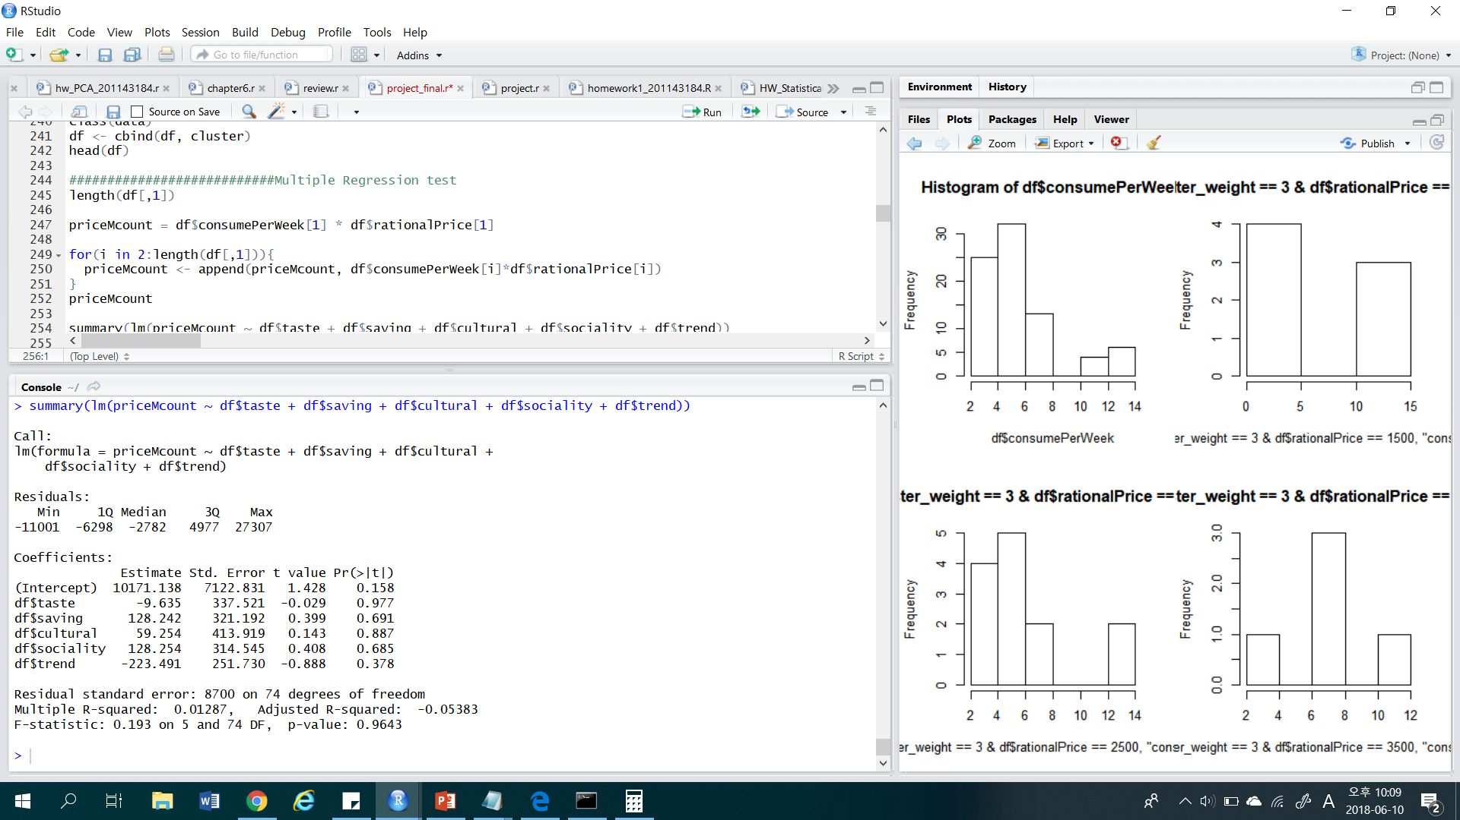
ANALYSIS PROCESS
Multiple Regression
Lifestyle variables
There was no meaningful variables in Lifestyle patterns of people.
So, we used other variables that people consider when they purchase coffee.
Notes:
But, When we fitted multiple linear regression, We couldn't find any meaningful variables
in lifestyle patterns.
So, we used other factors.

Slide 14
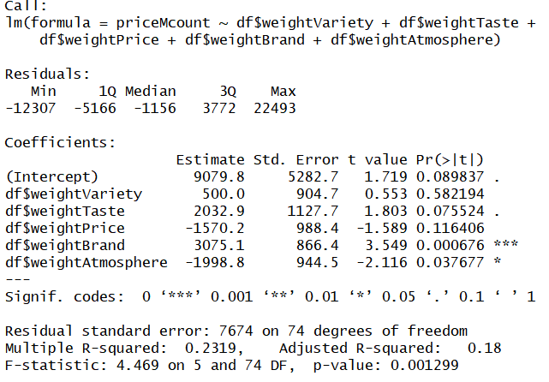
ANALYSIS PROCESS
Multiple Regression
Weighted variables
when people purchase coffee
In 0.05 significance level :
weightBrand,
weightAtmosphere (are meaningful).
In 0.1 significance level :
weightBrand, weightAtmosphere,
weightTaste (are meaningful).
Adjusted R-squared :
0.18 ( very low value to explain
the regression model. )
Notes:
At this analysis, we found that some of weight factors reject Null hypothesis.
that means those variables have meaningful values in regression model.
However, if we looked at the R-square values,
18% is too low value to predict a meaningful results.
so, we continued the cluster analysis.

Slide 15
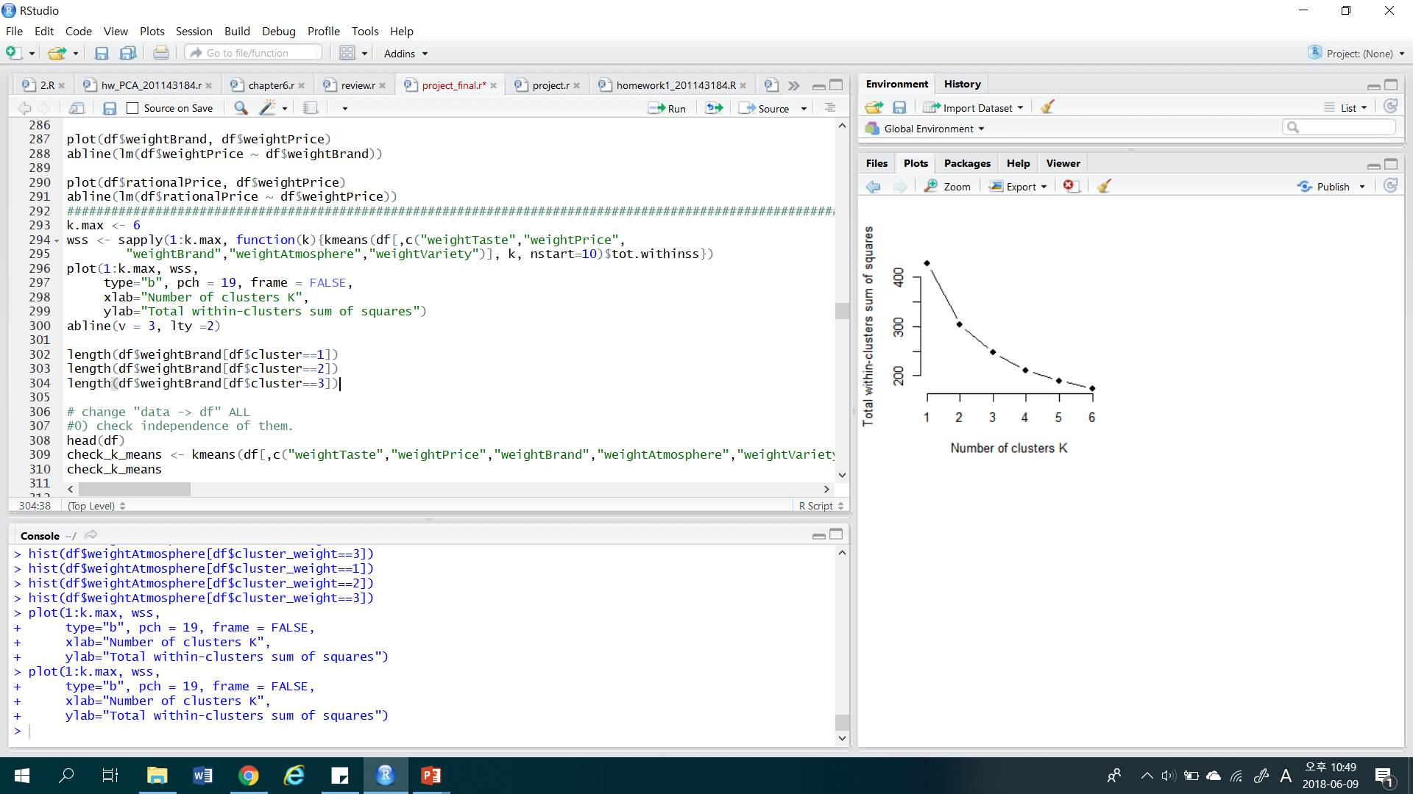
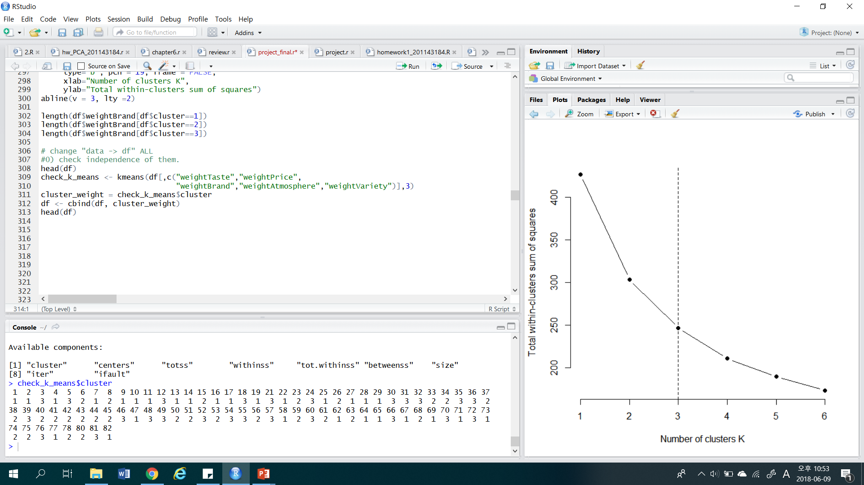
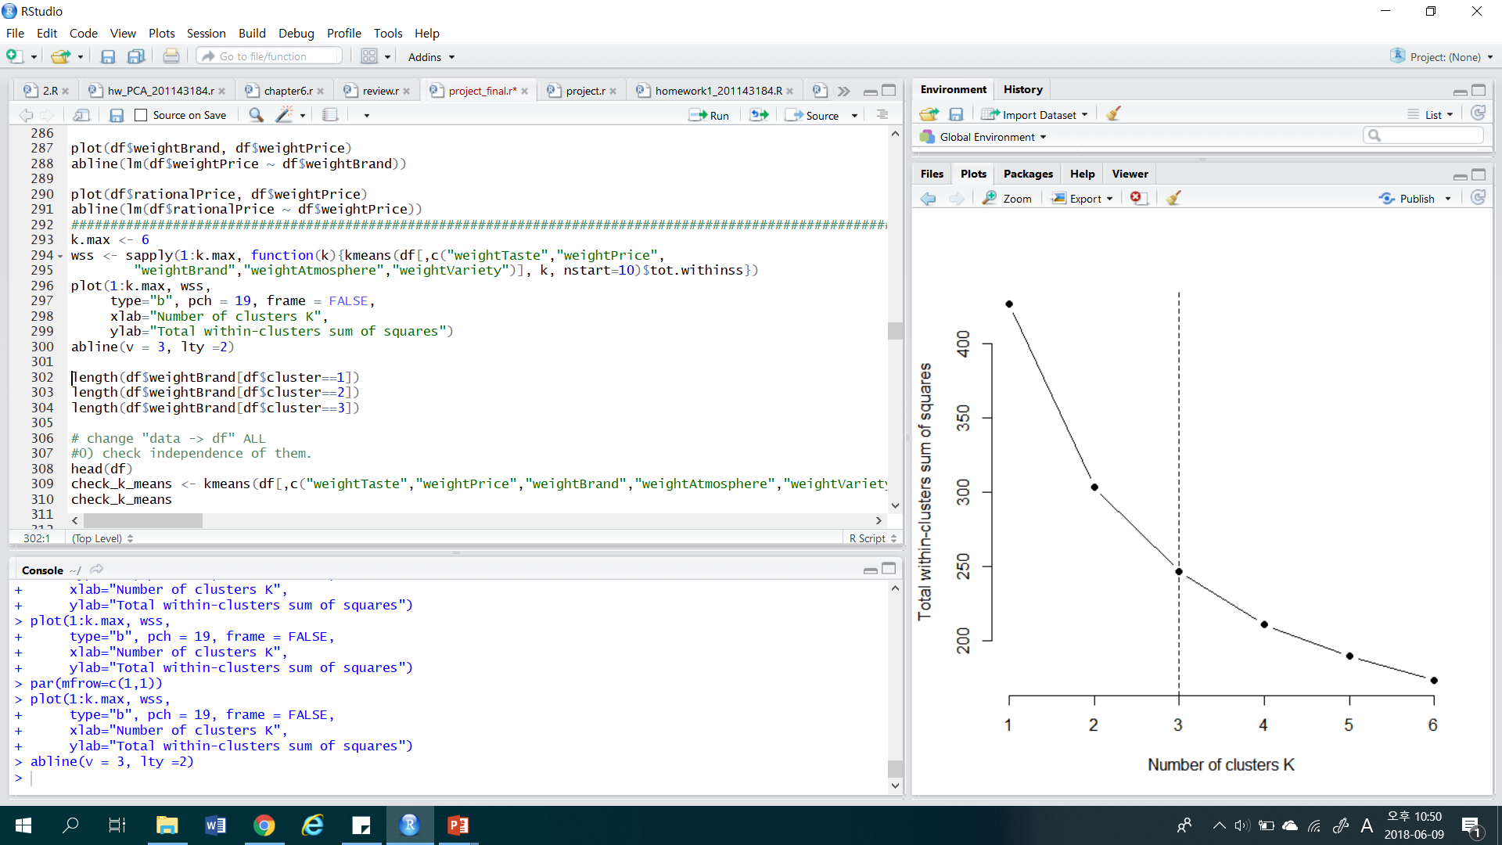
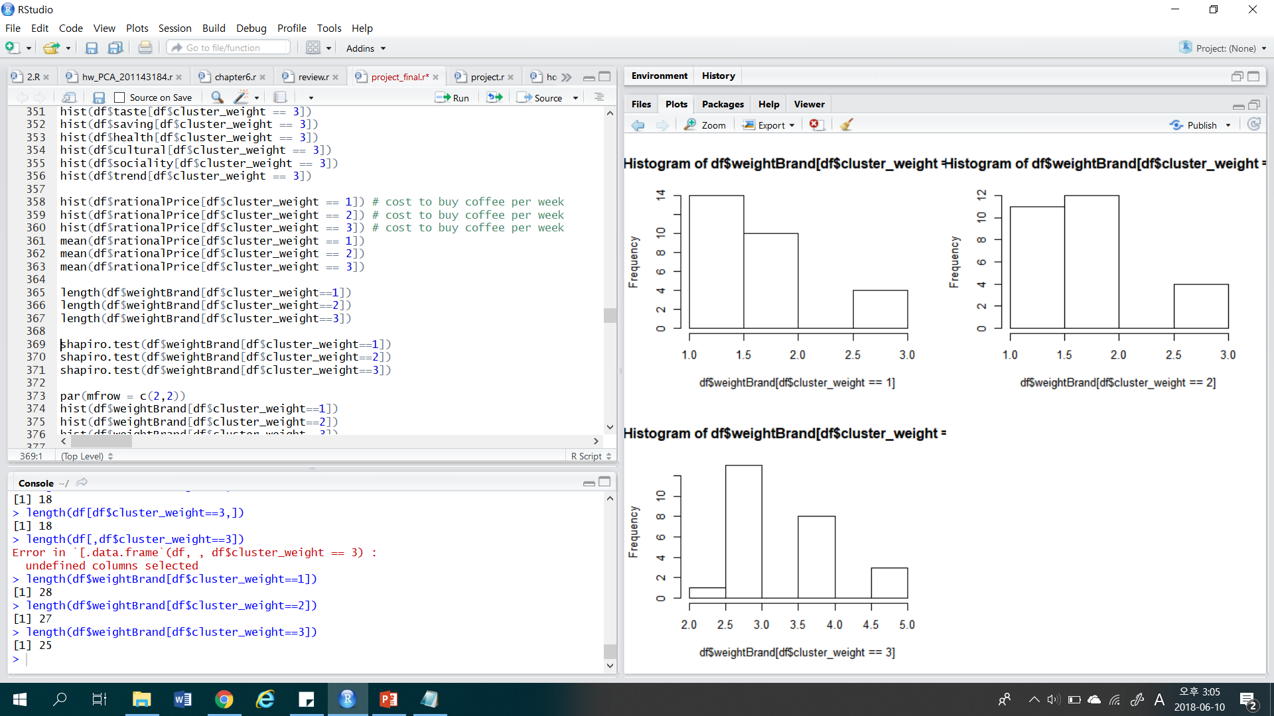
ANALYSIS PROCESS
Clustering
[ Elbow method ]
We used elbow method to choose the number of clusters.
Elbow method : choose the number where gradient change is rapidly slowed.
[ Number of clusters ]
Notes:
to determine the number of clusters, we used Elbow method.
this is method that choose the number of clusters where gradient change is rapidly slowed.
As a result we got a 3 clusters.

Slide 16
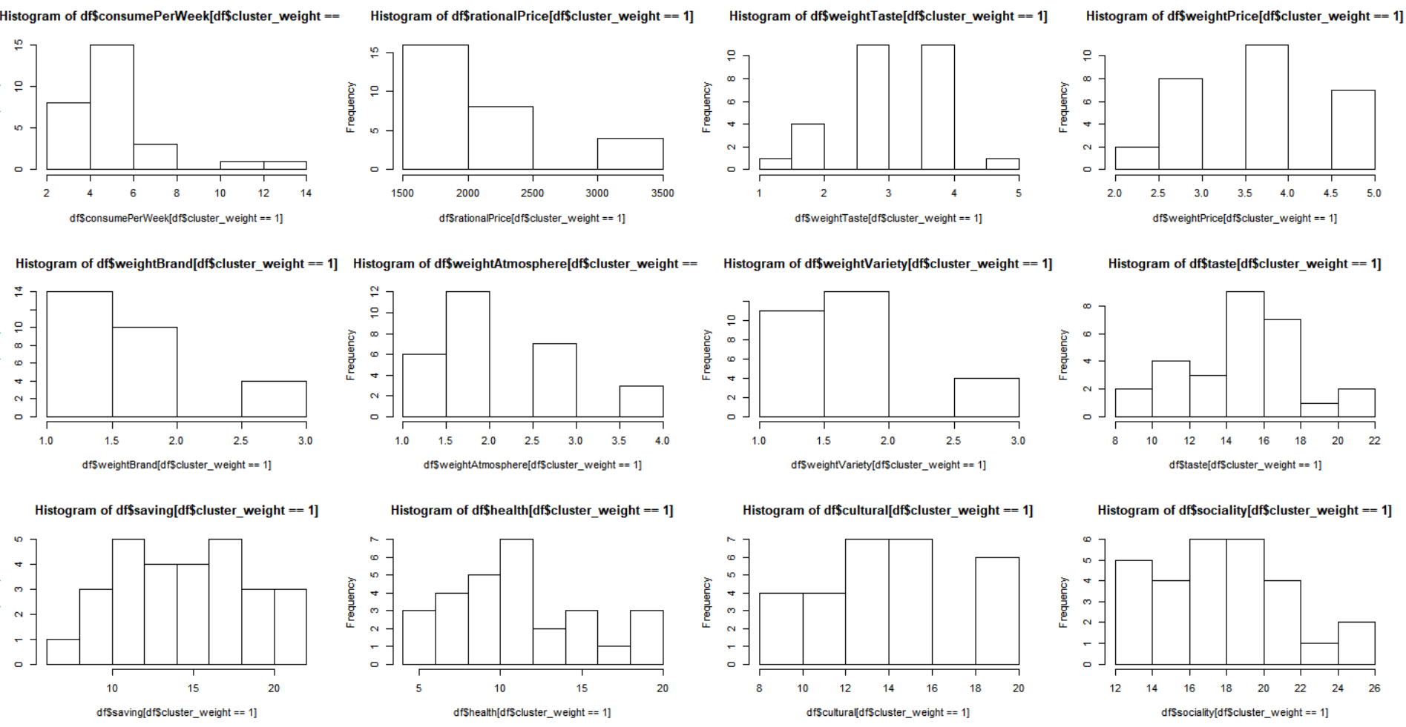
ANALYSIS PROCESS
Histogram of clusters
Notes:
I will skip checking distribution of each clusters.

Slide 17
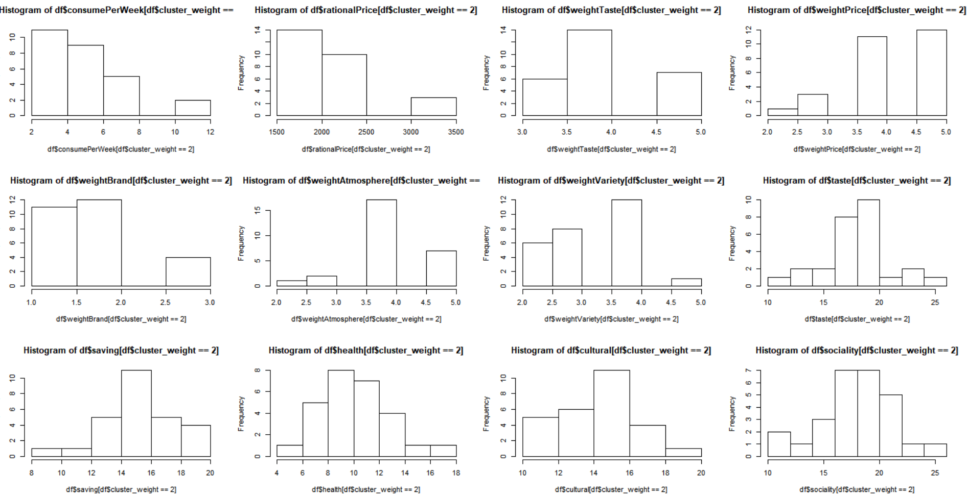
ANALYSIS PROCESS
Histogram of clusters

Slide 18
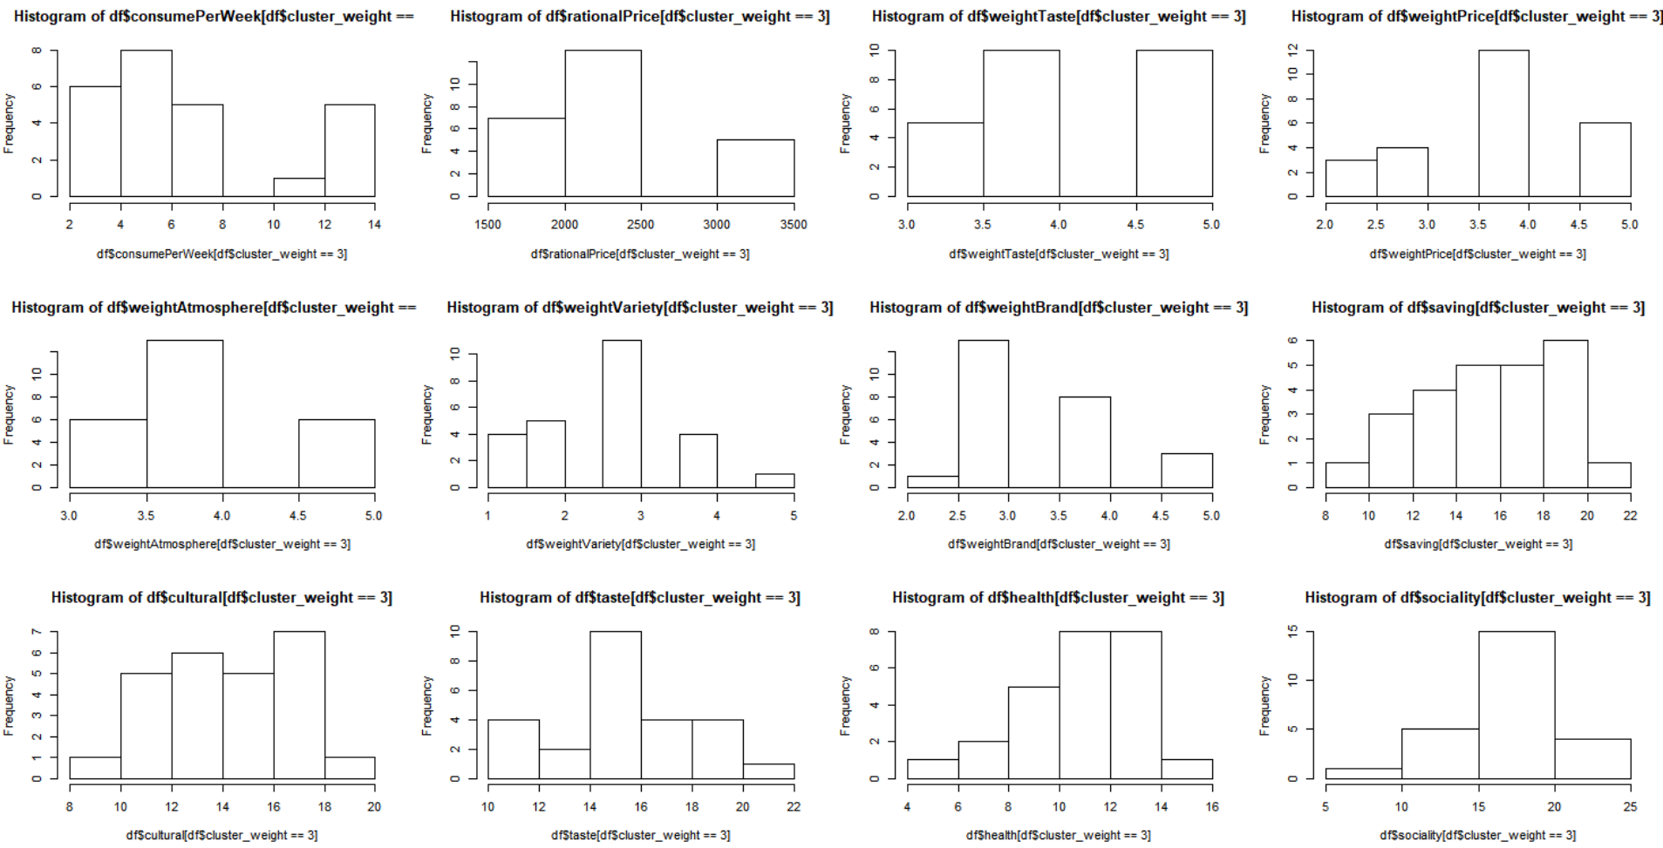
ANALYSIS PROCESS
Histogram of clusters

Slide 19
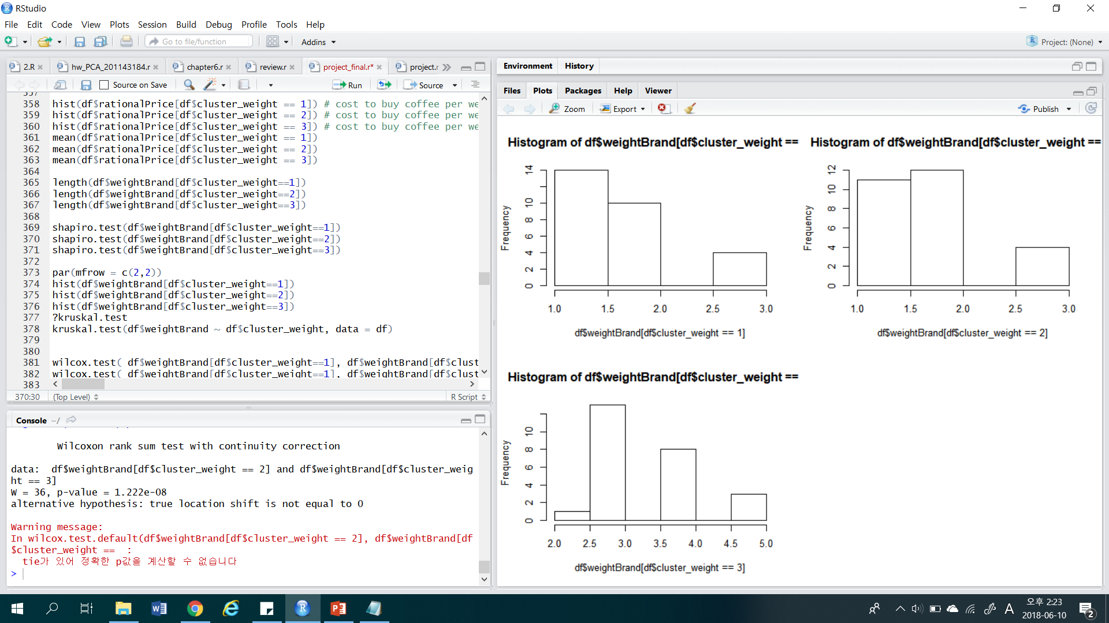
ANALYSIS PROCESS
Histogram of clusters
-Weight Brand
[ Cluster 1 ]
[ Cluster 2 ]
[ Cluster 3 ]
- When we look at the histogram, There was a difference between cluster 3 and the others. So, to check the difference among them, we planned to ANOVA test. - To do that, We should check the below 3 points.
1) Independent 2) Normality 3) Equal variance
Notes:
Instead, I will show the biggiest difference.
The biggest difference of each cluster was the values about brand weight.
to precisely check the difference among them, we planned ANOVA test.
We should check the below 3 points when we take anova test.
Independent, Normality, Equal variance.

Slide 20
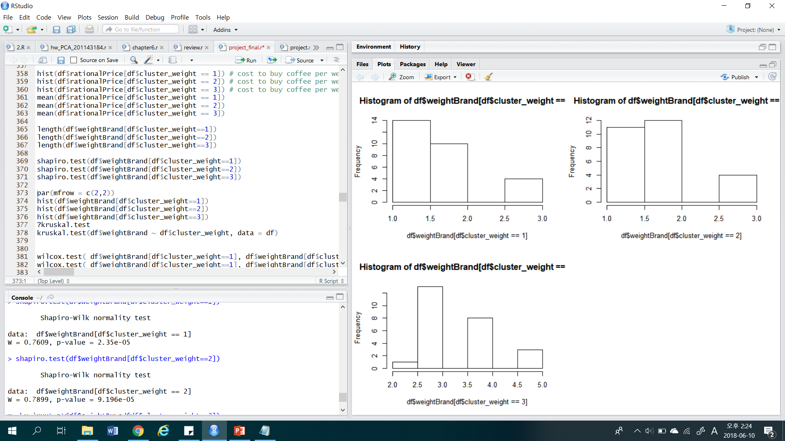
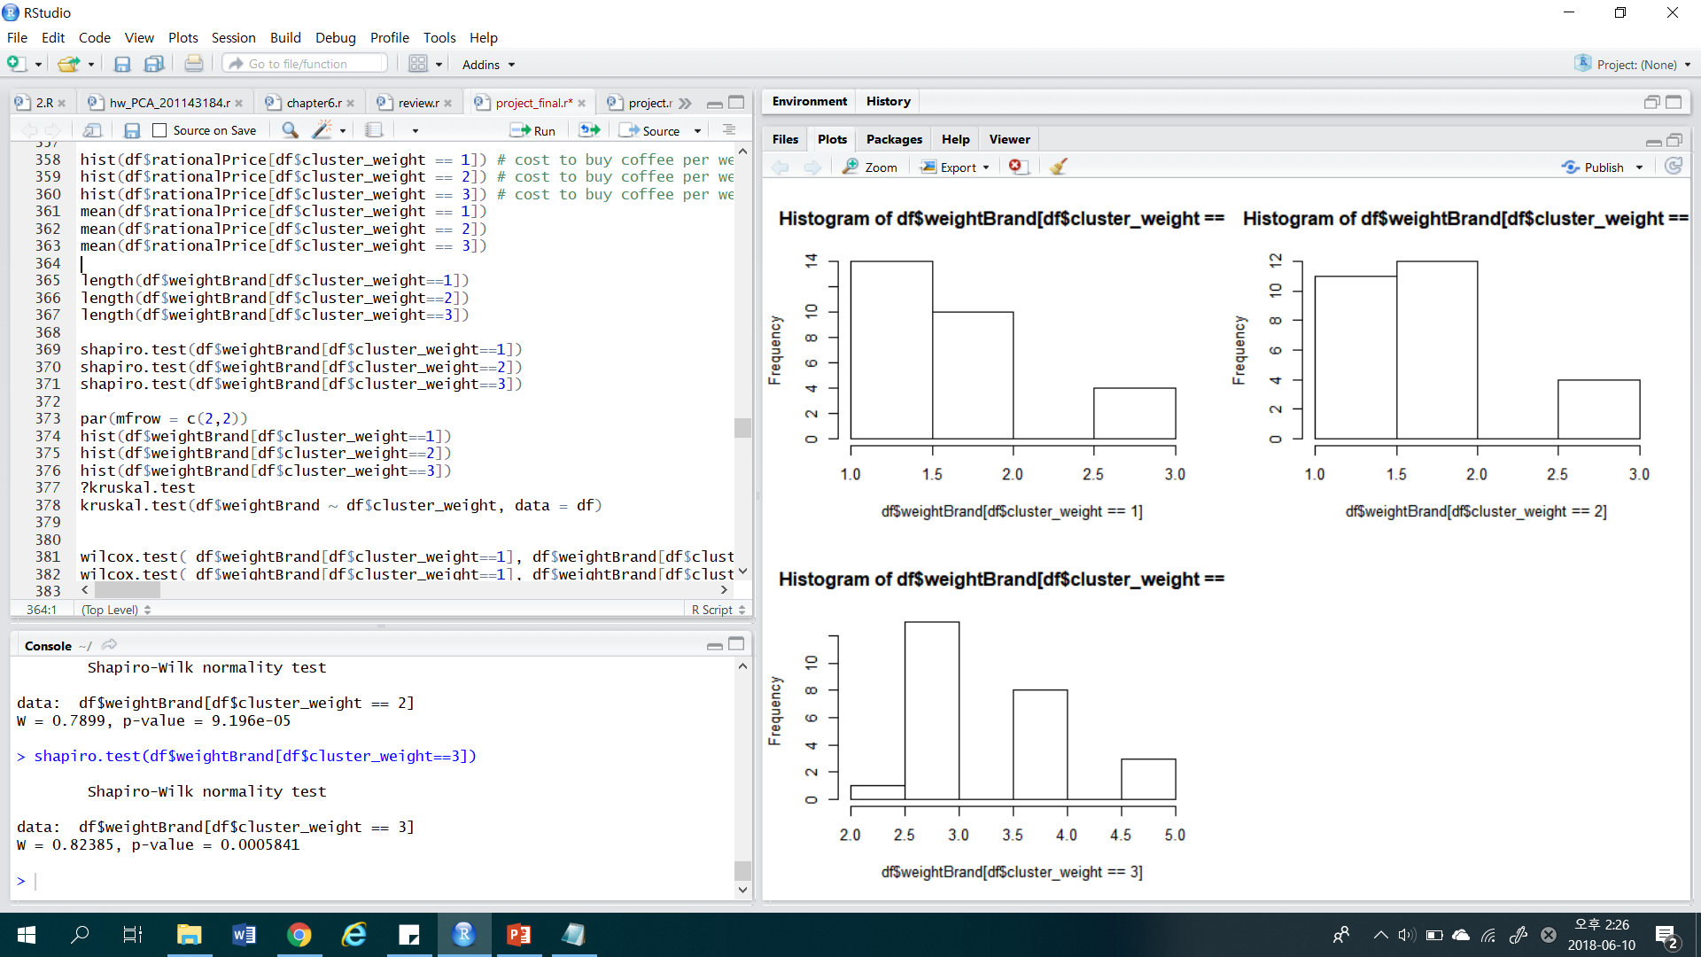
ANALYSIS PROCESS
Check prerequisite of ANOVA
[ Normality check ]
[ Histogram of clusters ]
[ Results ]
P-values : less than 0.05 Reject H0 : data sets satisfy normality Select H1 : data sets are not satisfying normality.
Notes:
So, we checked normality of variables using shapiro test.
but all of them rejected null hypothesis.
our cluster sample size is less than 30, we can't adapt Central limit theory too.
so, it can't not satisfy normality.

Slide 21
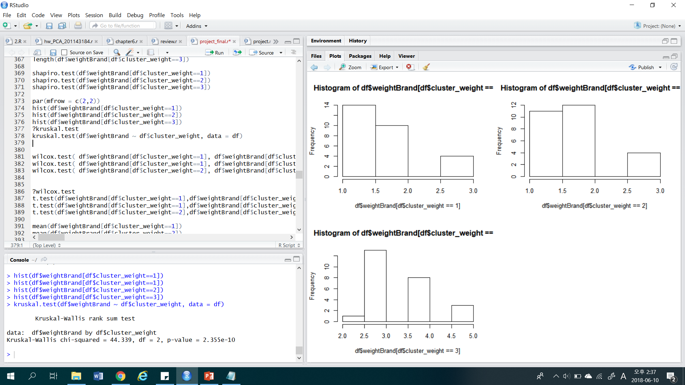
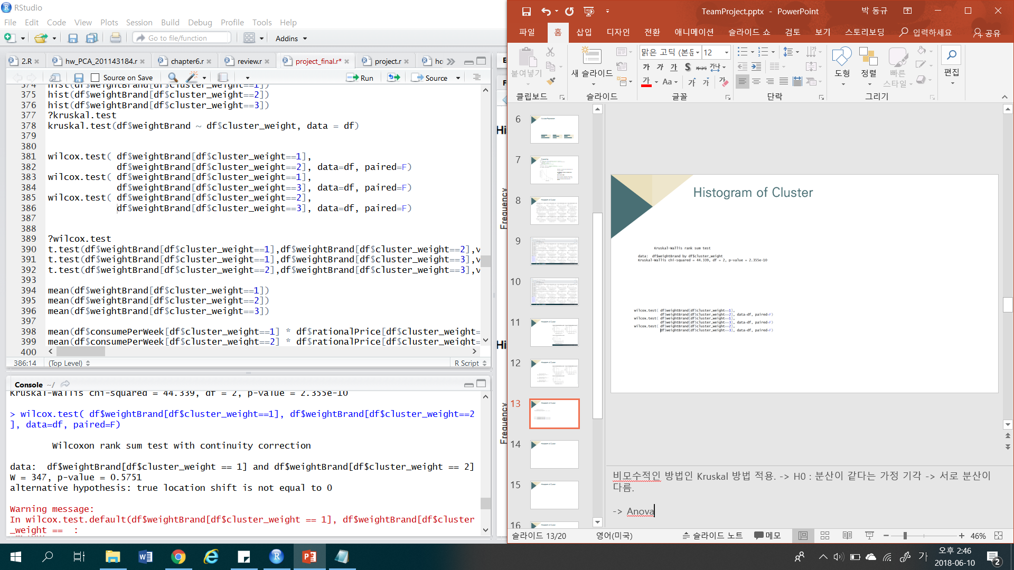
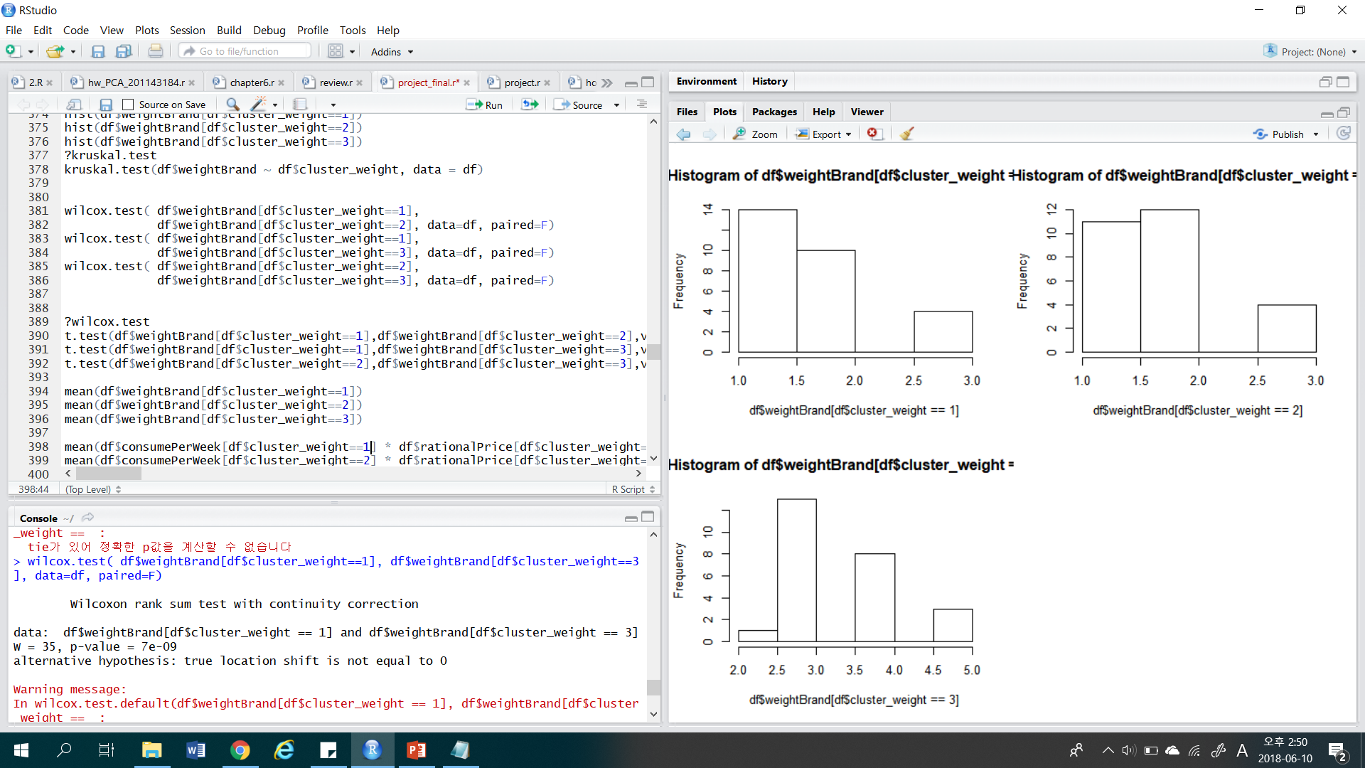

ANALYSIS PROCESS
Kruskal & Wilcoxon test
Kruskal test
[ Results ] * P-values : less than 0.05 * Reject H0 : there’s no difference between group. * Select H1 : there’s a difference between group.
Wilcoxon test
[ Results ] * P-values : greater than 0.0167 * Select H0 : There’s no difference between cluster 1 and cluster 2
[ Results ] * P-values : less than 0.0167 * Select H1 : There’s a difference between cluster 1 and cluster 3
[ Results ] * P-values : less than 0.0167 * Select H1 : There’s a difference between cluster 2 and cluster 3
* Used significance level 0.0167 in Wilcoxon test. ( 0.05 / 3 = 0.0167)
Notes:
so, we used kruskal test instead of anova test. it is test similar to anova,
but use when normalitiy assumtion is not satisfied.
as p-value of kruskal test is less than 5%, we could say that there's difference in brand weight,
among clusters.
and then, we used wilcoxon test to check the difference of cluster means.
It is used instead of t-test
and Only third cluster showed the meaningful difference of brand weight

Slide 22
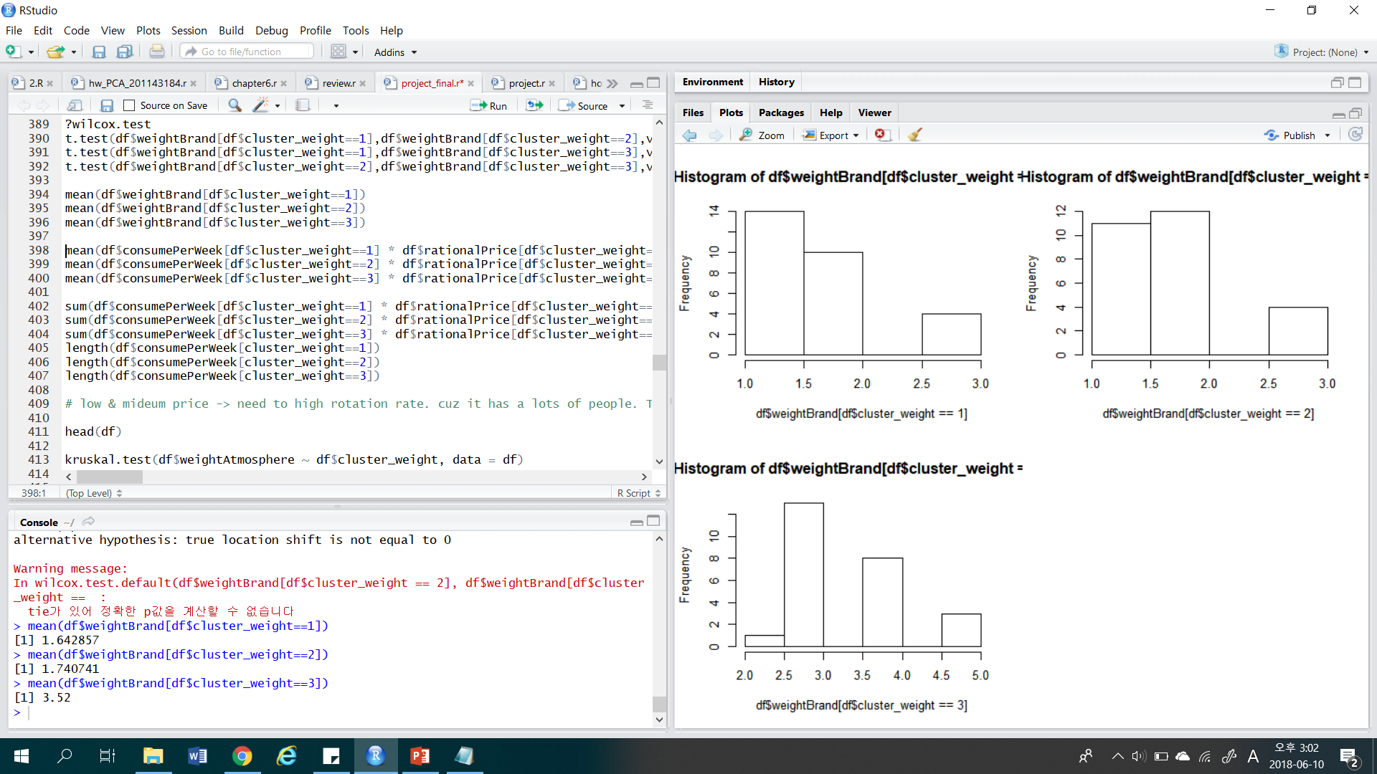
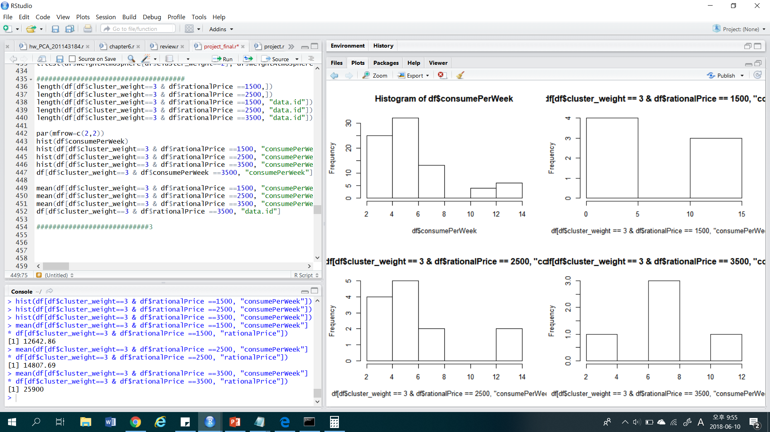
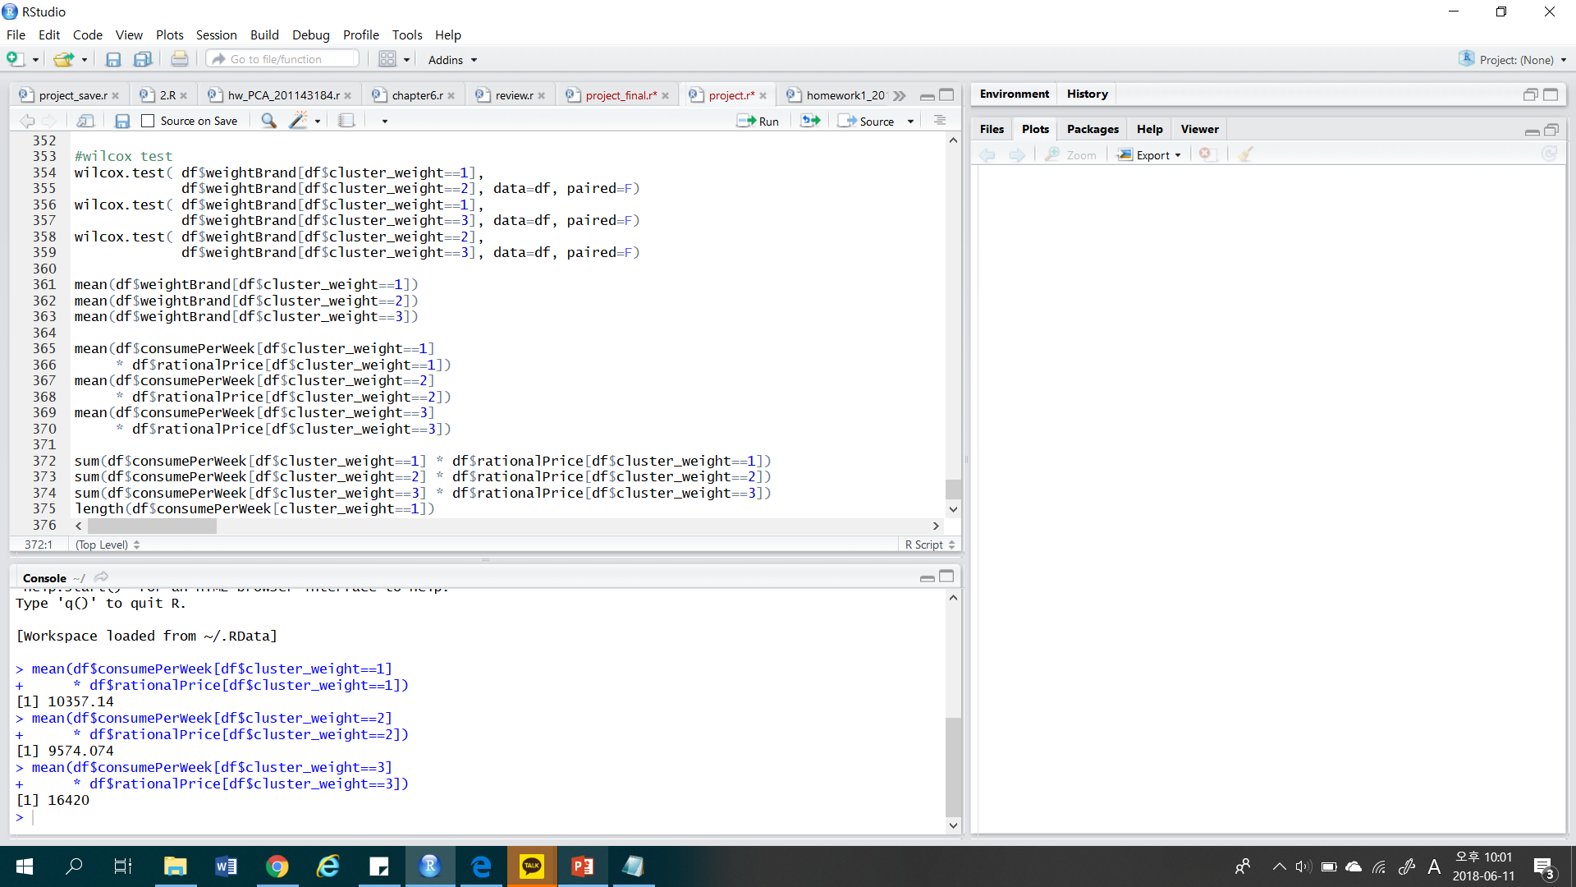
ANALYSIS PROCESS
Mean of brandWeight
Mean cost buying coffee in cluster 3
Mean cost buying coffee
Cluster 3 piad most to consume coffee.
We dig into the cluster 3 according to the difference of affordable coffee price.
We thought that there is notifying difference. So, we tried Wilcoxon test again.
Notes:
the cluster 3 showed the highest brand weight.
and the highest mean cost buying coffee.
At here, we digged into the cluster 3 according to the difference of affordable coffee price.
we thought that there is notifying difference.
so, we tried wilcoxon test again.

Slide 23
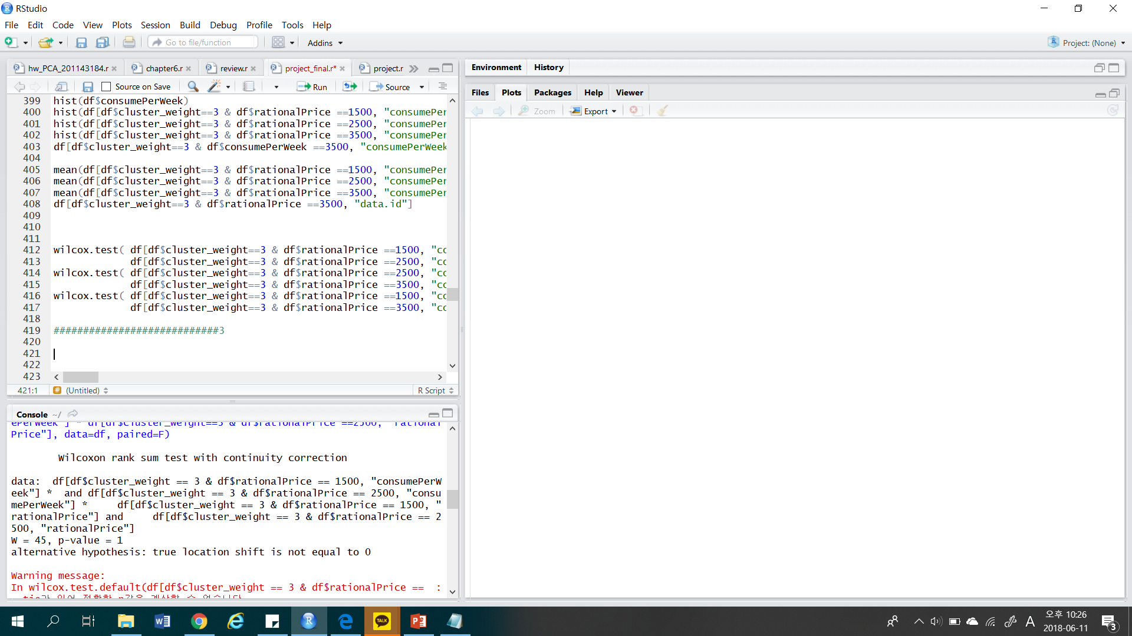
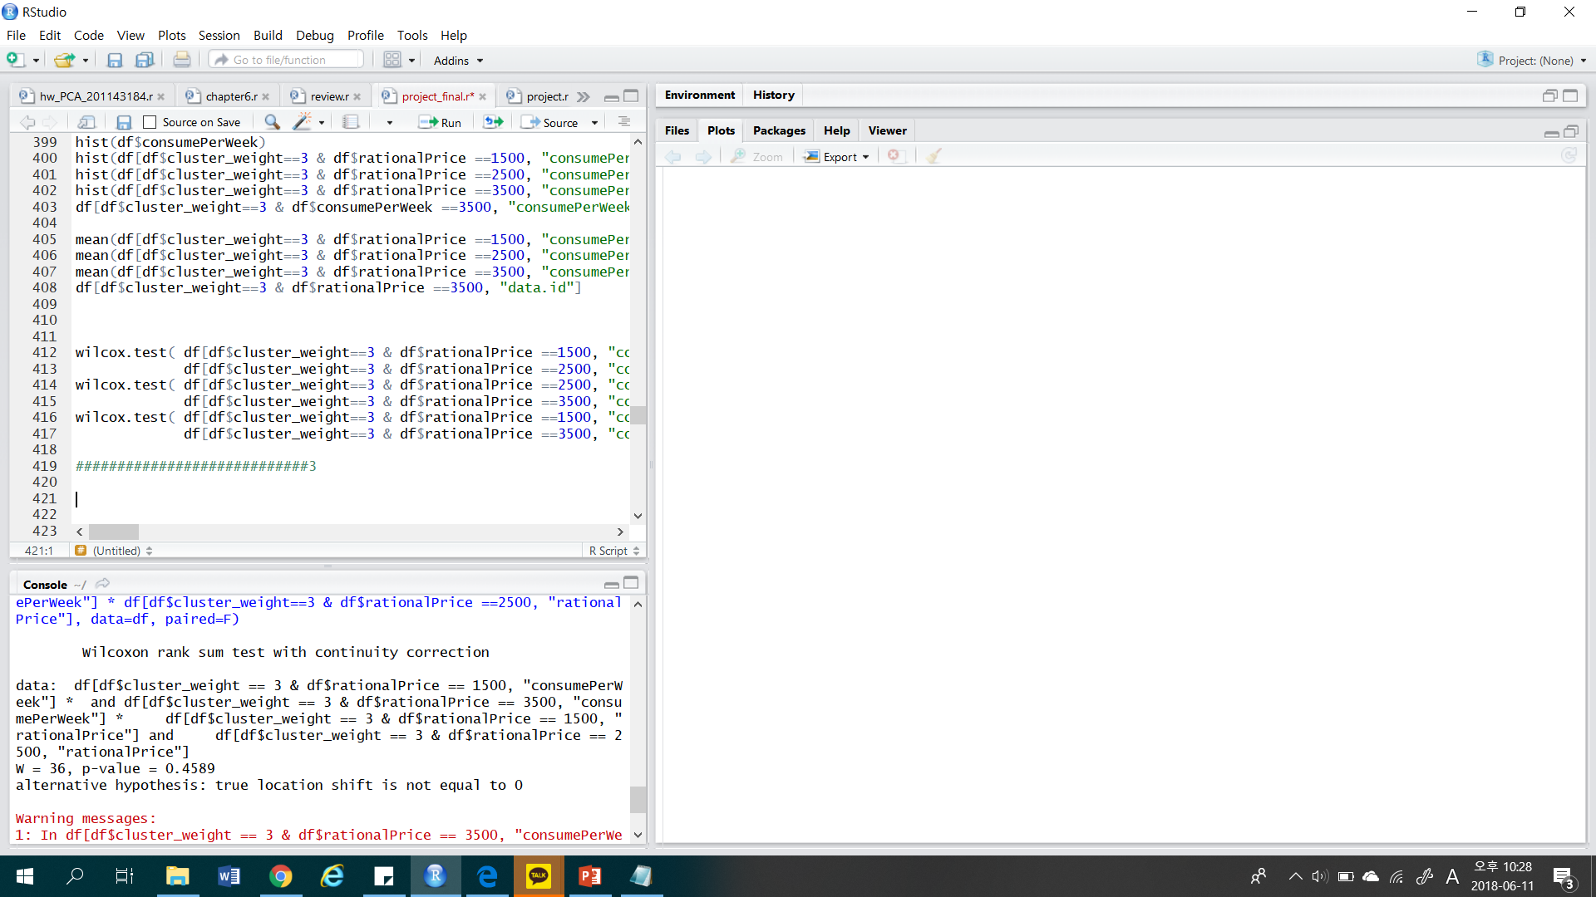

ANALYSIS PROCESS
[ Wilcoxon test ]
[ Results ] : group of affordable cost 1500 & 2500 * P-values : greater than 0.0167 * Select H0 : there’s no difference between group.
[ Results ] : group of affordable cost 1500 & 3500 * P-values : greater than 0.0167 * Select H0 : There’s no difference between group .
[ Results ] : group of affordable cost 2500 & 3500 * P-values : less than 0.0167 * Select H1 : There’s a difference between group.
Notes:
But, only test between group 2500, and 3500 rejected the null hypothesis.
In my opinion, the sample size affected the results between 1500 & 3500.

Slide 24


ANALYSIS CONCLUSION
: characteristics of most profitable group
2) Willing to buy
high price coffee
1) High weight on Brand
Brand was one of the important issues buying coffee.
People who are willing to pay high price, make the highest profit.
Notes:
So, our conclusion is that.
1) most profitable group have high weight on brand. (maybe I think they have strong brand loyalty to specific brand)
At first, when we checked the distribution of survey, we thought that brand is not a important
variable in buying coffee.
But, when we digged into the data, that was not true. people who are interest in brand
makes the highest profit.
2) among this group, people who are willing to pay for expensive coffee spend most to buy coffee.
through these conclusions,
Maybe we could understand why starbucks is the most profitable pranchise
in coffee market. cuz they targeting high price market, managing brand image,
and focus on brand loyalty of customers.

Slide 25


LIMITATION OF PROJECT
2) Lack of access to customer purchase data sets
1) Insufficient sample data sets
To make a robust conclusion, We need more data samples. This sample data size is too small.
To make a more insights, We need customer purchase data
Notes:
now, I will finish my presentation after checking the limitation of this project
first, to make a robust conclusion, we need more data samples.
this dample data size is too small.
and second, to make a more insights, we need a customer purchase data sets.
cause we don't know who have high values on brand. and we need to trace the people
who are getting brand loyalty.

Slide 26
THANK YOU
Notes:
Thank you for listening our presentation.

